Slide 1


ASANSOL ENGINEERING COLLEGE
DEPARTMENT OF INFORMATION TECHNOLOGY GROUP NUMBER-19
Under the guidance of Mr. Tapas Pal

Slide 2


BHOJANALAYA'4U
Online Restaurant Order App
PRESENTED BY
BIKRAM KUMAR PANDIT(10800220050)
SUBHAM GHOSH (10800220051)
ROHIT MUKHERJEE (10800220052)
SWATI DAS (10800220055)

Slide 3


INTRODUCTION
In the ever-evolving world of online food ordering, the Bhojanalaya'4U Online Restaurant Order App stands out. Built with the trio of HTML, CSS, and JavaScript, it provides a seamless journey through the delicious offerings of our restaurant. Imagine an interactive platform where users can browse our menu, place orders, and track deliveries with ease. This project, like a digital concierge, lets users explore dishes, customize their orders, and enjoy a smooth ordering experience.

Slide 4

PROJECT OBJECTIVE
Our objective is to make Bhojnalaya 4U the top choice for authentic Indian cuisine, known for its wide variety of dishes, excellent quality, and unforgettable dining atmosphere. By focusing on smart marketing and operational efficiency, we strive to consistently go above and beyond customer expectations, engage with our community, and ensure steady growth in the competitive restaurant market.

Slide 5
Mission: To deliver a diverse array of delicious, high-quality meals quickly and conveniently, supporting local restaurants and ensuring exceptional customer satisfaction through innovative technology and sustainable practices.
Content
Vision: To become the leading online food delivery platform known for exceptional service, diverse culinary offerings, and a strong commitment to community and sustainability.
Image: Inspirational image, such as
a family enjoying a meal together

Slide 6
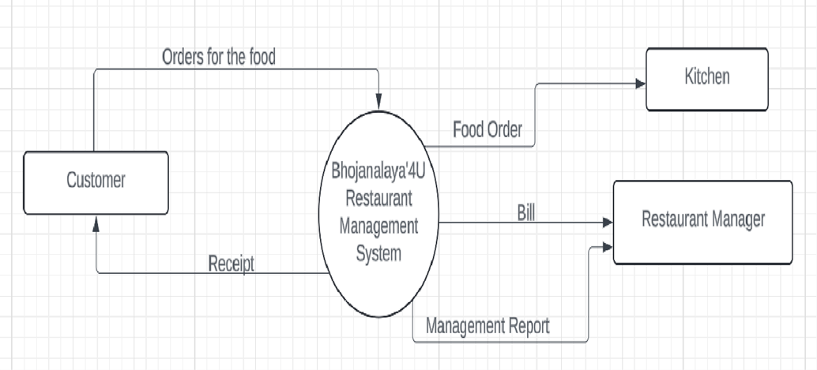
LEVEL 0 DFD :

Slide 7
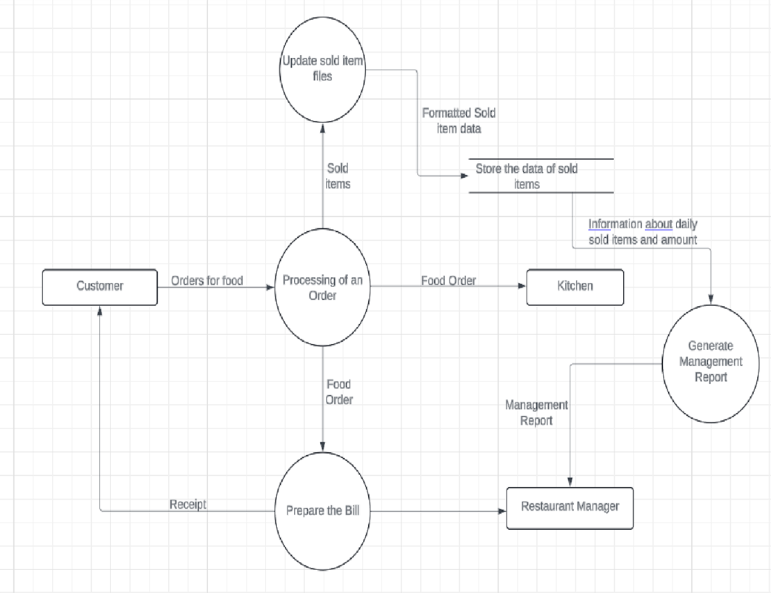
LEVEL 1 DFD :

Slide 8
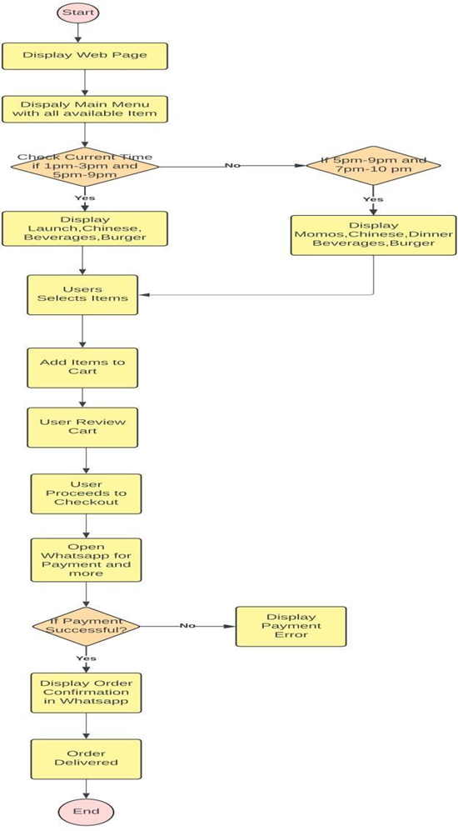
WORKFLOW OF THE PROJECT :

Slide 9

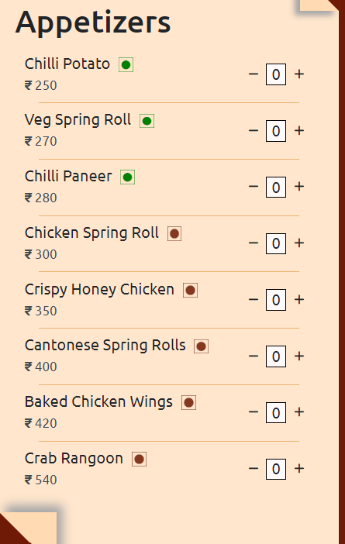
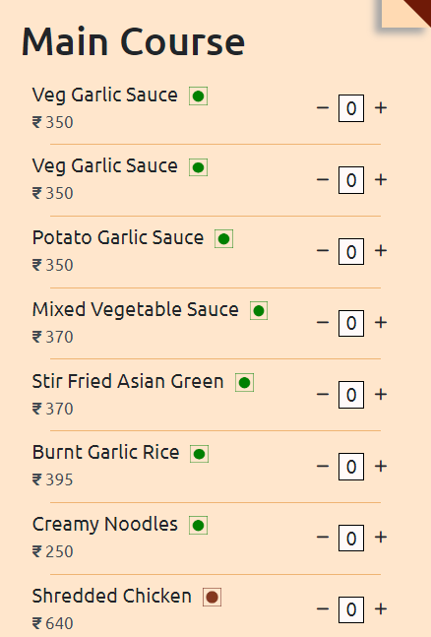
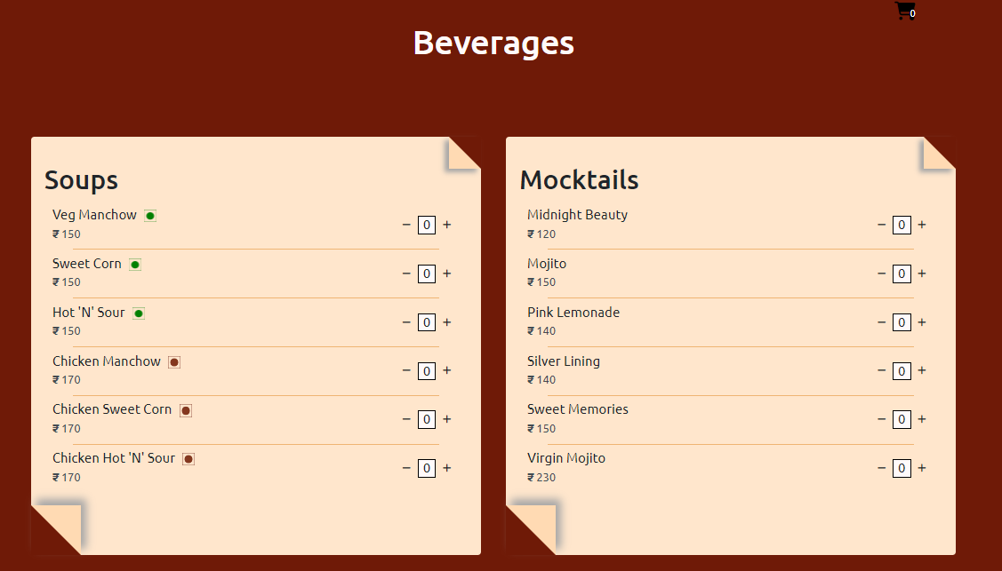
Menu Highlighted

Slide 10

Special Features
Title: Special Features
Bengali Thali Availability: Daily from 1 PM to 3 PM
Description: Experience the rich and diverse flavors of Bengal with our traditional Bengali Thali. Each thali is meticulously prepared to bring you a taste of Bengal's culinary heritage.
Dinner Set Availability: Daily from 7 PM to 10 PM
Description: Savor a delightful and wholesome dinner with our specially curated Dinner Set, offering a balanced and satisfying meal for your evening.

Slide 11
Commitment to Hygiene and Quality
At Bhojnalaya 4U, we prioritize your health and safety by adhering to the highest standards of hygiene and quality assurance. Here’s how we ensure every meal you receive is safe, nutritious, and delicious :
Eat Sure Assured Goodness Verified
Medically Certified Kitchen Staff: Our kitchen staff undergo thorough medical examinations and hold certifications to ensure they are fit and qualified to prepare your meals.
200+ Stringent Quality Checks: From sourcing ingredients to final delivery, our process includes over 200 rigorous quality checks to maintain exceptional standards of hygiene and taste.
No Artificial Colours or Flavours: We believe in natural goodness. Our meals contain no artificial colors or flavors, guaranteeing authentic and wholesome taste.
Double Sealed Packaging: To preserve freshness and prevent any contamination, each meal is securely double-sealed, ensuring it arrives at your doorstep in perfect condition.
With Bhojnalaya 4U, enjoy peace of mind knowing that every meal is prepared and delivered with the utmost care for your health and satisfaction.

Slide 12
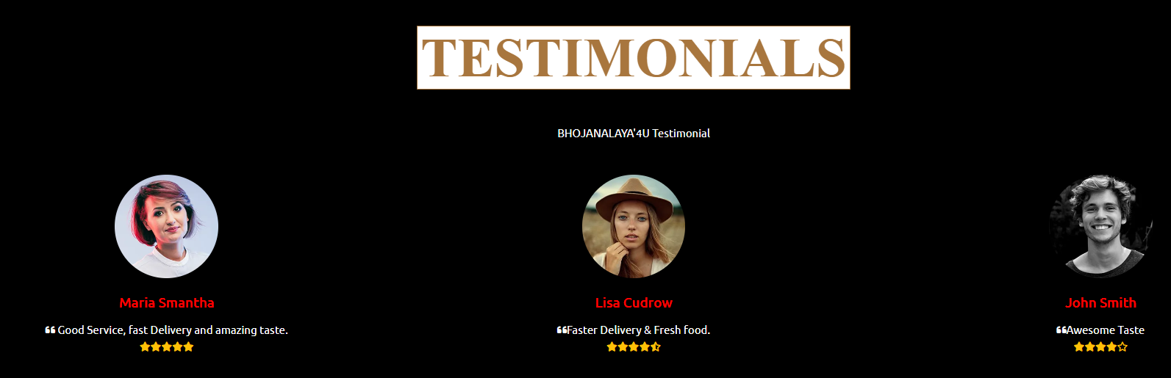
Customer Testimonials

Slide 13
At Bhojnalaya 4U, we understand that engaging with our customers is key to building lasting relationships and ensuring a satisfying experience. Here are some of the strategies we use to keep our customers engaged:
Personalized Experience
Customized Orders: Allow customers to customize their orders to suit their taste and dietary preferences.
Recommendations: Use customer data to offer personalized meal recommendations based on past orders and preferences.
Interactive Website and App Features
User-Friendly Interface: Ensure a smooth and easy ordering process with an intuitive website and app design.
Live Tracking: Allow customers to track their orders in real-time from the kitchen to their doorstep.
Feedback System: Incorporate a feedback system where customers can rate their meals and delivery experience.
Social Media Engagement
Active Presence: Maintain active social media profiles on platforms like Facebook, Instagram, and Twitter to engage with customers and share updates.
User-Generated Content: Encourage customers to share photos of their meals and experiences, and feature these posts on your social media channels.
Community Engagement

Slide 14

Contact Information
Website Name: Bhojnalaya 4U
Website: WEBSITE LINK
Email: bhojanalaya4u@gmail.com
Phone: +91-6206483575
Address: Bhojnalaya ‘4U,1234 Gouranga Mandir Road,Near City Mall,Asansol, West Bengal 713301,INDIA
Social Media:
Facebook: facebook.com/bhojnalaya4u
Twitter: twitter.com/bhojnalaya4u
Instagram: instagram.com/bhojnalaya4u
Feel free to customize this information based on your actual contact details and social media handles.

Slide 15
THANK YOU

